Slide 1
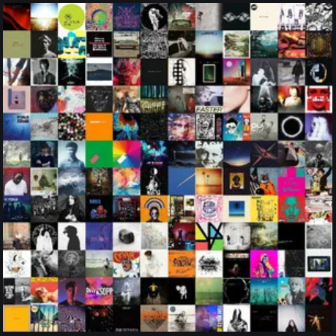

What did the World Listen to in the last Decade
2010 - 2020

Slide 2

Researched Data 2010 – 2020
Most Played artist
2010 -2019
Most Popular Genre
2010 - 2019
Popularity, Trend and Demographic
2010 -2019

Slide 3
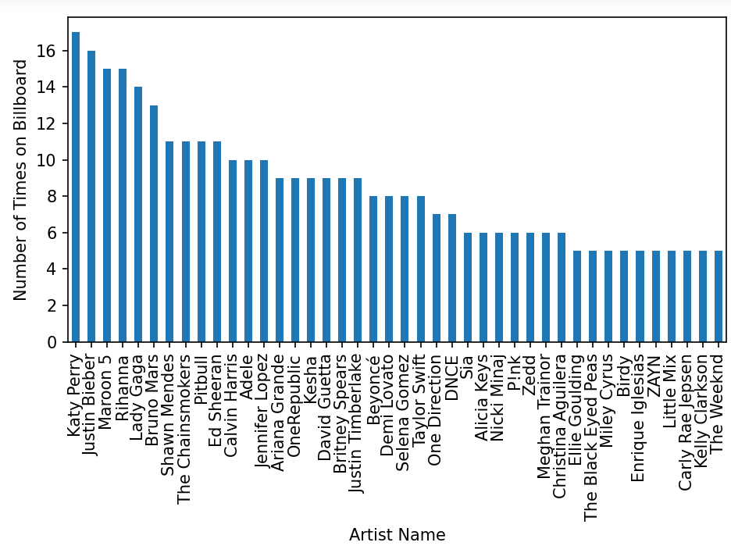
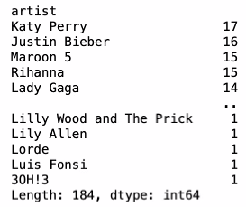
Most Played artist 2010 -2020
As 2020 ended, so does a stellar year of streaming on Spotify with great data. You may be reflecting on the past 10 years, thinking about your own music discoveries and the songs you repeated over, and over, and over. You will be able to see that within our data throughout the whole world who was the most played artist. We dove into the newcomers, showstoppers, and top performers who united the globe with music in the last 10 years.

Slide 4
Most Popular Genre 2010 - 2020
When if comes to Popular Genre’s most of these artists have operated through the more traditional avenues of recording blockbuster albums and staging splashy live shows over the past 10 years. If you’ve caught any of the 2010s’ to 2020’s megastars in concert, you’ve seen some creative, even eccentric, uses of the stadium – whether it’s Beyoncé doing a multimedia spectacle with rotating stages and a wardrobe full of costumes, or Perry cavorting in a Croft Brothers-style fantasy land. Bieber’s last tour was a fully-fledged psychodrama that hinged on his ambivalence about his own stardom. When he towered above the audience, locked in a cage, you couldn’t help feeling you were seeing a modern riff on Pink Floyd’s The Wall. We have used data from Spotify to pull together the most played Genre for the last 10 years.

Slide 5
Popularity, Trends and Demographic 2010 -2020
The statistic provides data on Popularity, Trends and Demographics among consumers in the United States from 2010 to 2020. According to Spotify, 52 percent of respondents aged 16 to 19 years old stated that pop music was their favorite music genre, compared to 19 percent of respondents aged 65 or above(I need data for this

Slide 6
Summary

